Slide 1

Exploratory Data Analysis on AMCAT

Slide 2
About me
Name : Anushree K
Specialization: Master of Science in Statistics
Any Work Experience : Fresher

Slide 3
Objective of the Project:
• The objective of this project is to perform Exploratory Data Analysis (EDA) on the AMEO dataset to gain
insights into the employment outcomes of engineering graduates. Through data visualization and analysis, we
aim to understand salary distributions, job titles, job locations, skill assessments, and other relevant factors
impacting the employment landscape.
Data Description:
The dataset is derived from the Aspiring Mind Employment Outcome 2015 (AMEO) study, focusing on employment outcomes among engineering graduates. It includes information on various aspects such as salary, job titles, job locations, standardized scores in cognitive, technical, and personality skills, and demographic features. The dataset contains approximately 4000 data points with around 40 independent variables, comprising both continuous and categorical data.
Objectives:
1. Explore employment outcomes, focusing on salary, job titles, and locations.
2. Understand data distribution and identify outliers.
3. Investigate relationships between variables.
4. Address research questions regarding salary and gender-specialization preferences.
5. Provide actionable insights for career development, recruitment, and education in the engineering domain.

Slide 4
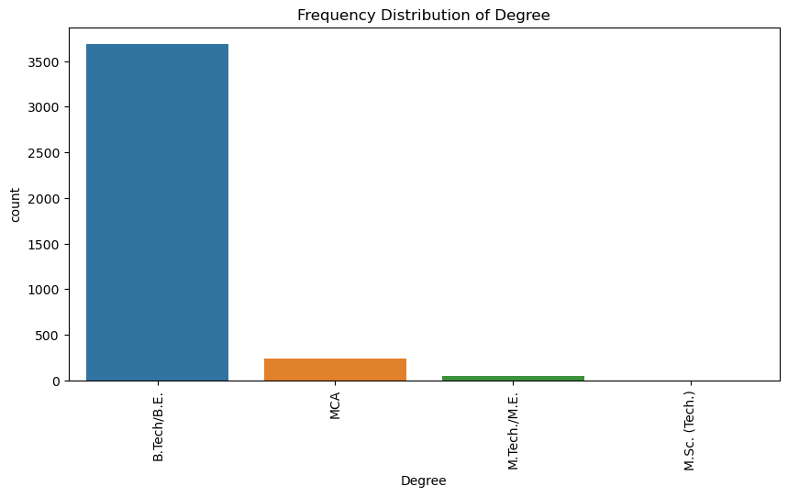
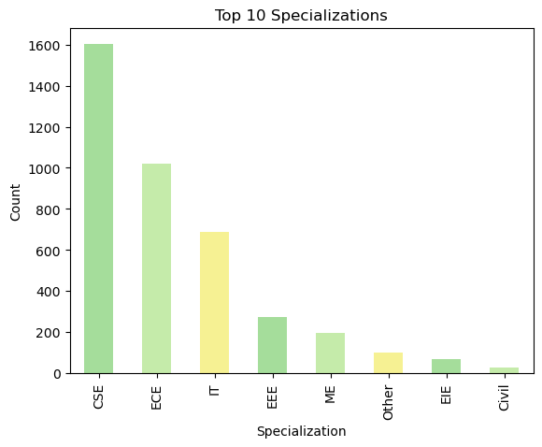
Univariate For Categorical Data:
The countplot illustrates that most employees hold a degree in BTech/BE, while a few have an MSc degree. Additionally, this plot provides insight into the distribution of various degree streams.
Most of them work in Software Engineering, while the fewest work as Java Developers.

Slide 5
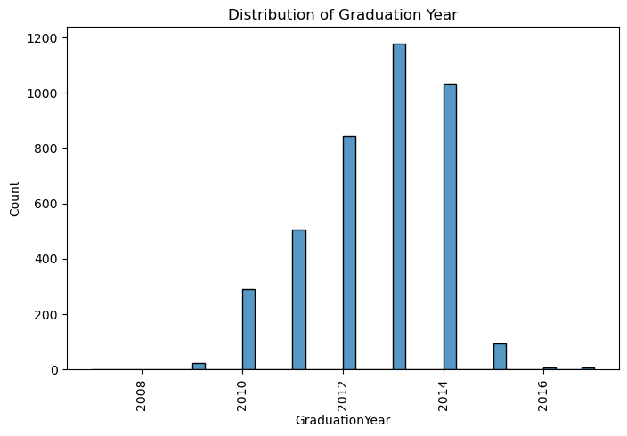
For Numerical Data
This histogram revelas that majority of employees are completed their GraduationYear in the year 2013

Slide 6
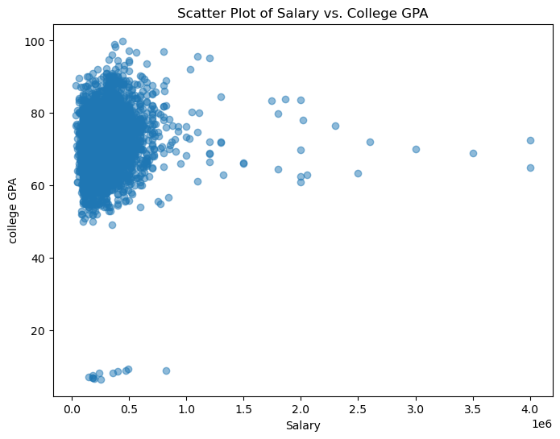
Bivariate Analysis Numerical VS Numerical
The scatter plot shows salary versus college GPA. Clusters of dots suggest similar salaries across GPAs at lower levels, while fewer dots are scattered at higher salaries, indicating a trend of fewer individuals earning higher incomes regardless of GPA.

Slide 7
Conclusion:
The dataset highlights a gender imbalance, underscoring the necessity for diversity initiatives in the workforce.
Technical skills, particularly in Computer Science and Engineering, are in high demand based on the prevalence of related degrees.
Job roles vary widely, with Software Engineer being the most common, followed by Developer.
Educational board preferences influence policies, with a preference for State Boards, CBSE, and ICSE.
Technical expertise is crucial, as evidenced by the prevalence of Bachelor of Technology/Engineering graduates.
Managerial and technical positions are the highest-earning roles.
College tier impacts earnings, with Tier-1 graduates earning more.
Gender-based salary differences exist, though further analysis is needed for clarity.
The data did not support the claim about recent graduates' earnings in Computer Science Engineering.
There's no significant link between gender and specialization preference, challenging assumptions about their correlation.

Slide 8

THANK YOU

